Slide 1
Serverless Chat System

Slide 2
What is Serverless?

Slide 3
Feature | Lamda | EC2
Access Time | milliseconds | seconds to minutes
configuration | function | Operating system
Scaling unit | Parallel function execution | instances
Maintenance | AWS | AWS and you

Slide 4

AWS Lamda
Function running on AWS
Options:
- Java
- Python
- JavaScript (Node.js)

Slide 5

AWS S3
S3 = Simple Storage Service
Key-Blob store
Eventually consistent
Extremely durable

Slide 6

AWS IAM
IAM – Identity and Access Management
users/groups
roles
policies
identity providers
user account settings
encryption keys

Slide 7

AWS COGNITO
Manage Users
Easy interface
Multi Factor authentication
Verification
Third party service integration

Slide 8

AWS API GATEWAY
End to end data transfer
JSON
Frontend-backend

Slide 9

AWS SES
Send Mails
No need to set up SMTP
No spam mails

Slide 10

AWS CODE COMMIT
Manage Code
Version control
Similar to Github
Can communicate with other AWS Services

Slide 11

AWS DYNAMO DB
No SQL Database
Very Dynamic
Highly accessible

Slide 12
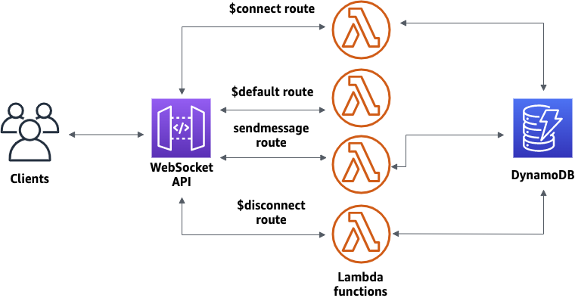

Slide 13
AWS Lamda
S3
AWS Cognito
IAM
API Gateway
AWS SES
AWS Code Commit
AWS Dynamo DB

Slide 14

Html, CSS, JS
Push it to S3
S3
Authentication
AWS Code Commit
Makes changes to Static website on function trigger
AWS Cognito
Verify
Function Trigger
AWS Lamda
Verify
Make changes to DB
AWS SES
AWS Dynamo DB

